Slide 1

Classifying : Microsoft Cybersecurity Incident
With Machine Learning
By
Gengatharan L

Slide 2
Problem Statement
As a data scientist at Microsoft, he/she is tasked with enhancing the efficiency of Security Operation Centers (SOCs) by developing a machine learning model that can accurately predict the triage grade of cybersecurity incidents.
Utilizing the comprehensive GUIDE dataset, the goal is to create a classification model that categorizes incidents as true positive (TP), benign positive (BP), or false positive (FP) based on historical evidence and customer responses.
The model should be robust enough to support guided response systems in providing SOC analysts with precise, context-rich recommendations, ultimately improving the overall security posture of enterprise environments.

Slide 3
Business Use Cases
The solution developed in this project can be implemented in various business scenarios, particularly in the field of cybersecurity. Some potential applications include:
Security Operation Centers (SOCs): Automating the triage process by accurately classifying cybersecurity incidents, thereby allowing SOC analysts to prioritize their efforts and respond to critical threats more efficiently.
Incident Response Automation: Enabling guided response systems to automatically suggest appropriate actions for different types of incidents, leading to quicker mitigation of potential threats.
Threat Intelligence: Enhancing threat detection capabilities by incorporating historical evidence and customer responses into the triage process, which can lead to more accurate identification of true and false positives.
Enterprise Security Management: Improving the overall security posture of enterprise environments by reducing the number of false positives and ensuring that true threats are addressed promptly.

Slide 4
Dataset Overview
The GUIDE dataset consists of over 13 million pieces of evidence across three hierarchical levels:
1. Evidence: Individual data points supporting an alert (e.g., IP addresses, user details).
2. Alert: Aggregated evidences indicating potential security incidents.
3. Incident: A comprehensive narrative representing one or more alerts.
4. Size: Over 1 million annotated incidents with triage labels, and 26,000 incidents with remediation action labels.
5. Telemetry: Data from over 6,100 organizations, including 441 MITRE ATT&CK techniques.
6. Training/Testing: The dataset is divided into a training set (80%) and a test set (20%), ensuring stratified representation of triage grades and identifiers.

Slide 5
Model Benchmarking and Optimization
Benchmarking
The GUIDE dataset aims to establish standardized benchmarks for guided response systems:
- Primary Metric: Macro-F1 score for incident triage predictions.
- Secondary Metric: Precision and recall for remediation action predictions.
Privacy Considerations
To protect sensitive information, the dataset underwent a stringent anonymization process, including:
- Pseudo-anonymization: Sensitive values are hashed using SHA1 to maintain uniqueness without revealing identities.
- Random ID Replacement: Hashed values are replaced with randomly generated IDs.
- Temporal Noise: Timestamps are modified to prevent re-identification.

Slide 6
Approach
Data Exploration and Understanding
Data Preprocessing
Exploratory Data Analysis (EDA)
Model Selection and Training
Model Evaluation and Tuning
Final Evaluation on Test Set
Final Results and Model Performance Analysis

Slide 7
Data Exploration and Understanding
Initial Inspection:
- Loaded the `GUIDE_train.csv` and 'GUIDE_test.csv' dataset and performed an initial inspection to understand the structure of the data, including the number of features, types of variables (categorical, numerical), and the distribution of the target variable (TP, BP, FP).
- Train Dataset contained - rows x columns (9516837, 45)
- Test Dataset contained - rows x columns (4147992 x 46)
- one extra column called usage(Public or Private, which won't be utilized as it isn't in our train data)
Exploratory Data Analysis (EDA): Use visualizations and statistical summaries to identify patterns, correlations, and potential anomalies in the data.

Slide 8
Data Preprocessing
Handling Missing Data and Duplicates: Identified missing values and dropped columns where missing values were more than 50% of the total rows. Duplicates were removed as well. Conversion of datatypes, for example string time to datetime done as well.
Feature Engineering: Create new features or modify existing ones to improve model performance. For example, combining related features, deriving new features from timestamps (like hour of the day or day of the week), or normalizing numerical variables.
Encoding Categorical Variables: Convert categorical features into numerical representations using techniques like one-hot encoding, label encoding, or target encoding, depending on the nature of the feature and its relationship with the target variable.

Slide 9
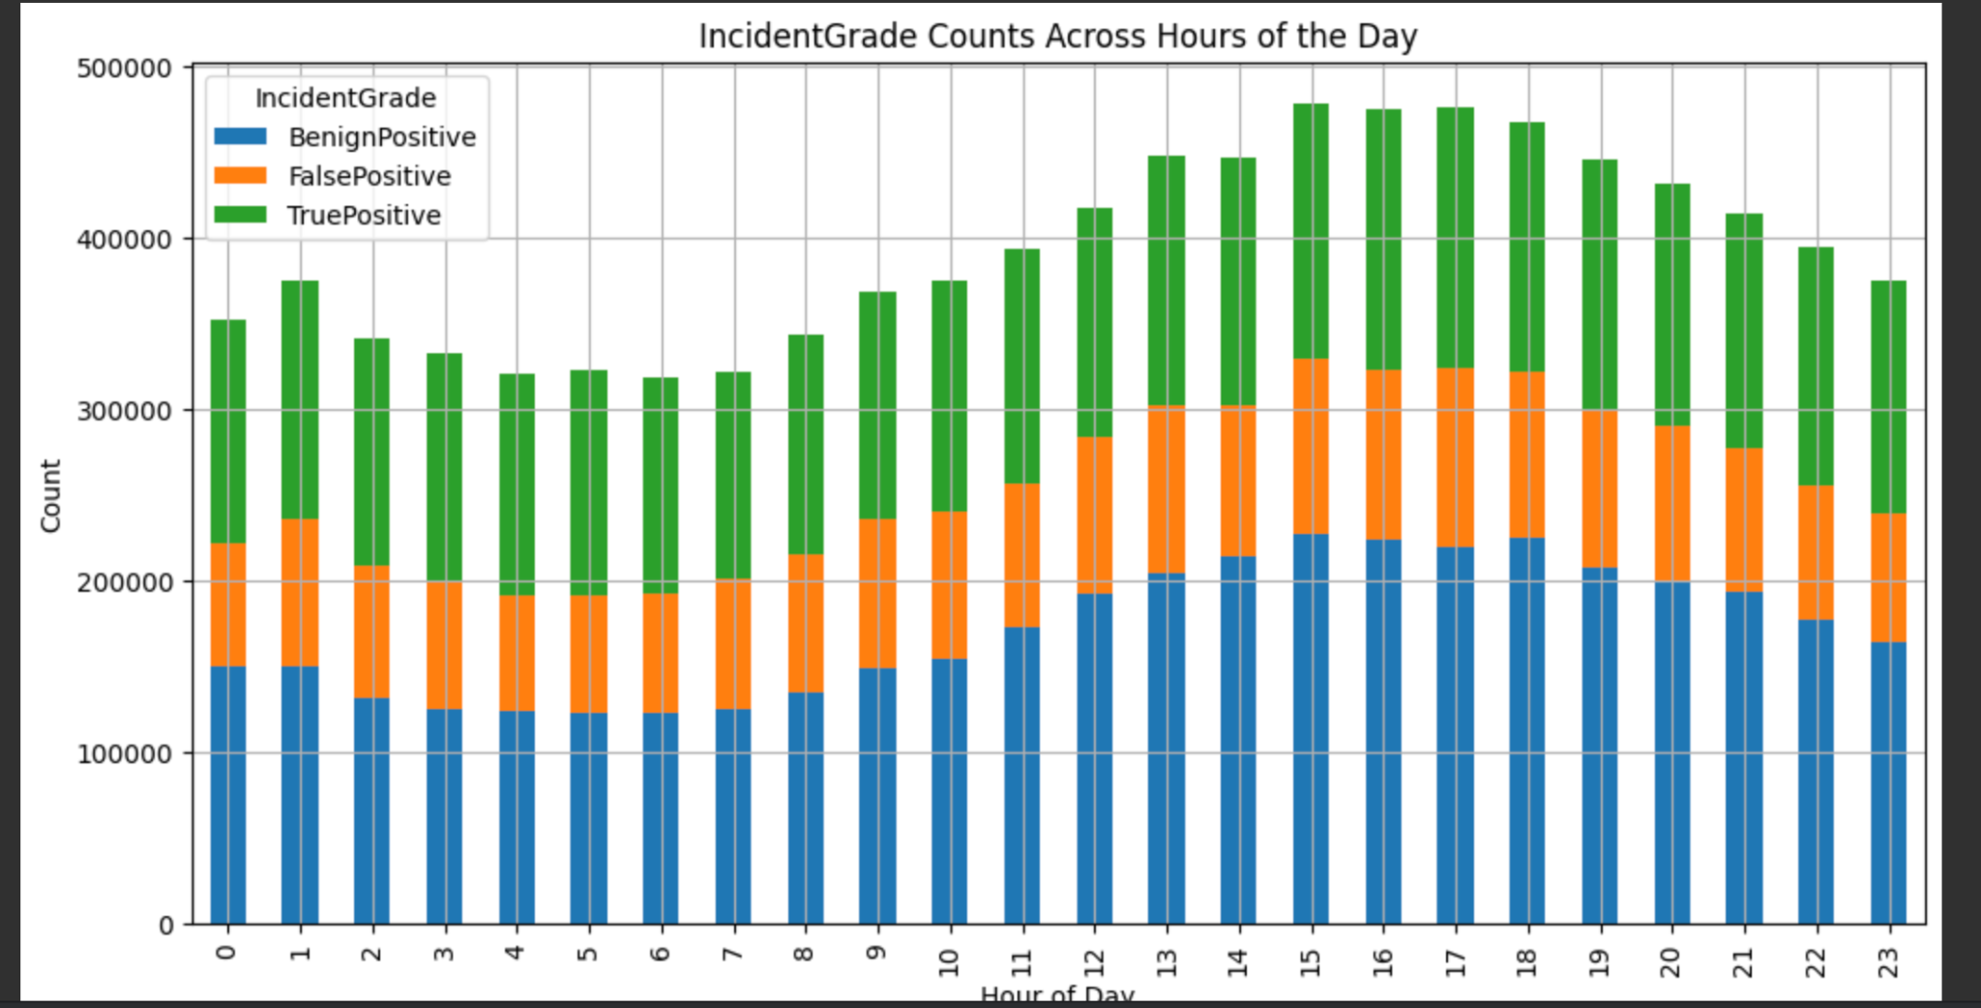
Exploratory Data Analysis
Derived new features from timestamps (like hour of day vs count of Incident Grade) or normalizing numerical variables.

Slide 10
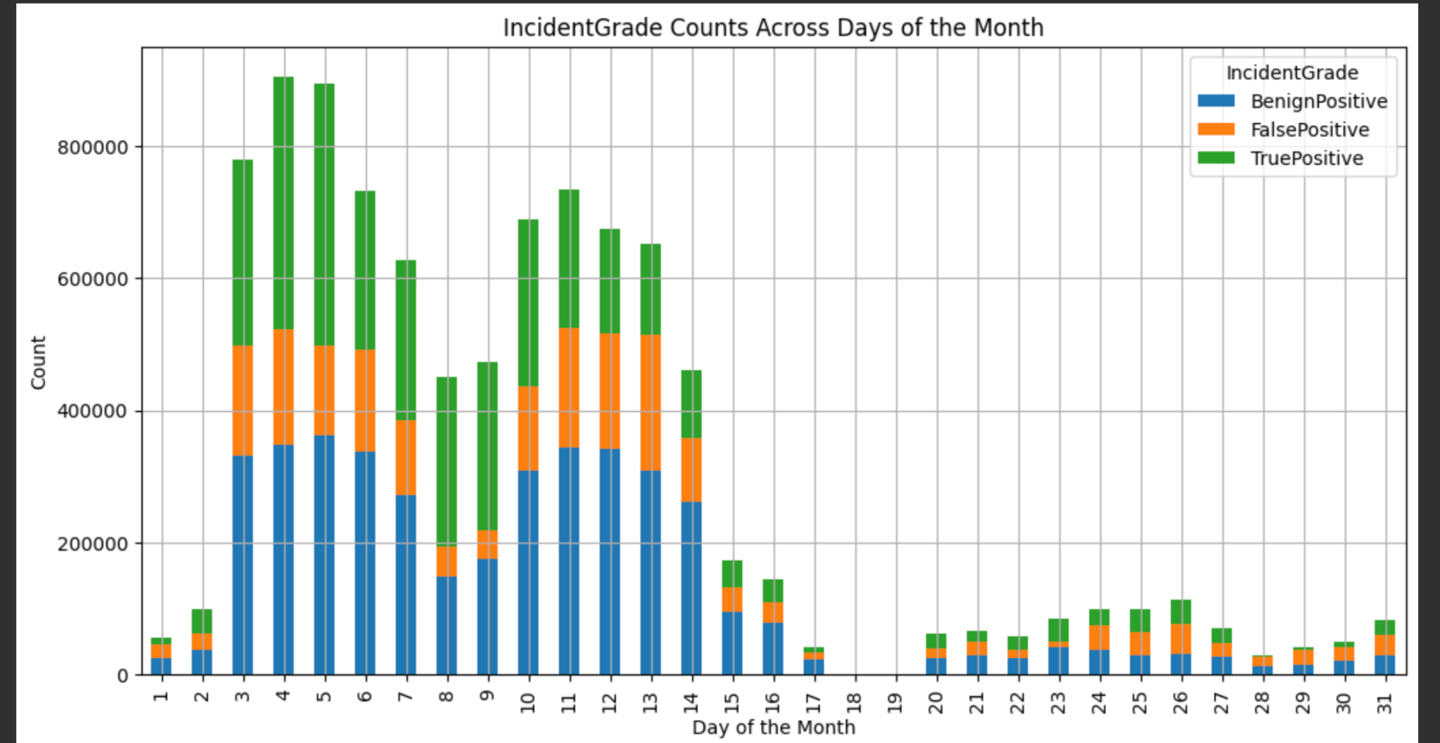
Exploratory Data Analysis
Derived new features from timestamps (like day of the month vs count of Incident Grade) or normalizing numerical variables.

Slide 11
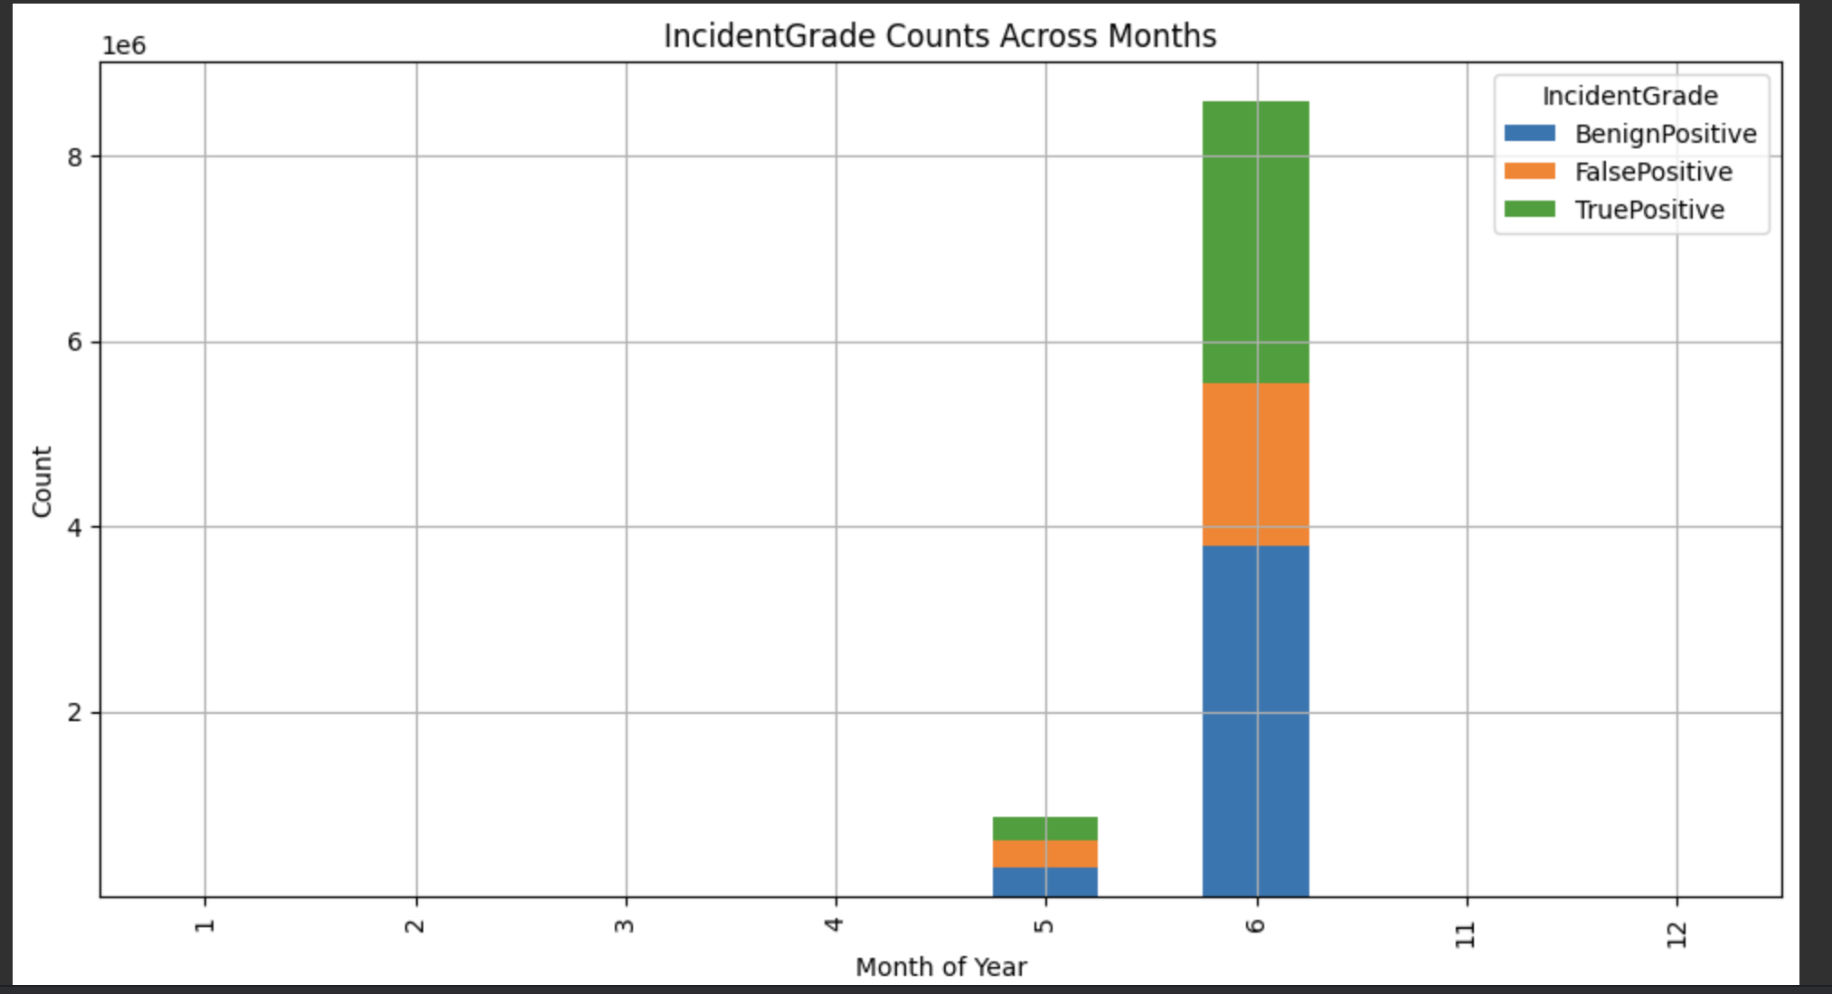
Exploratory Data Analysis
Derived new features from timestamps (like month of the year vs count of Incident Grade) or normalizing numerical variables.

Slide 12
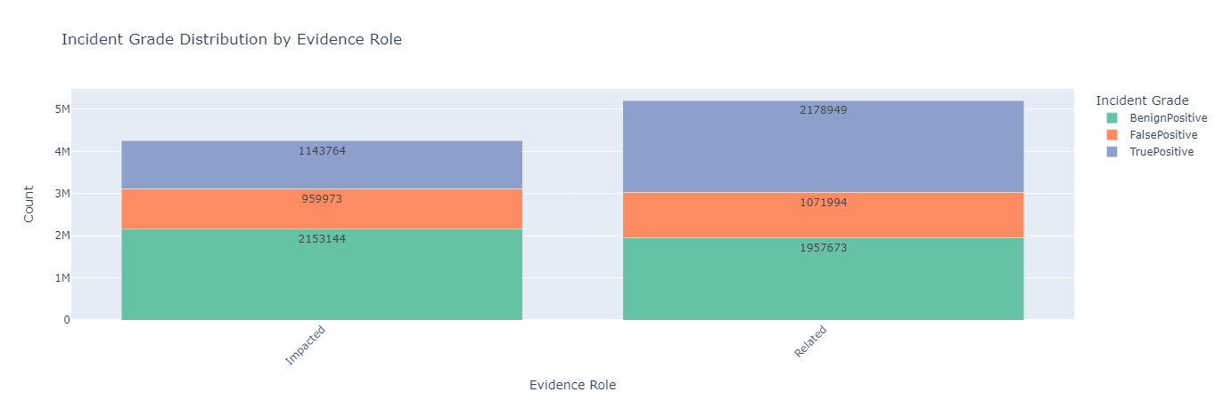
Exploratory Data Analysis
Incident Grade Distributed based on evidence role and its types are shown in figure

Slide 13
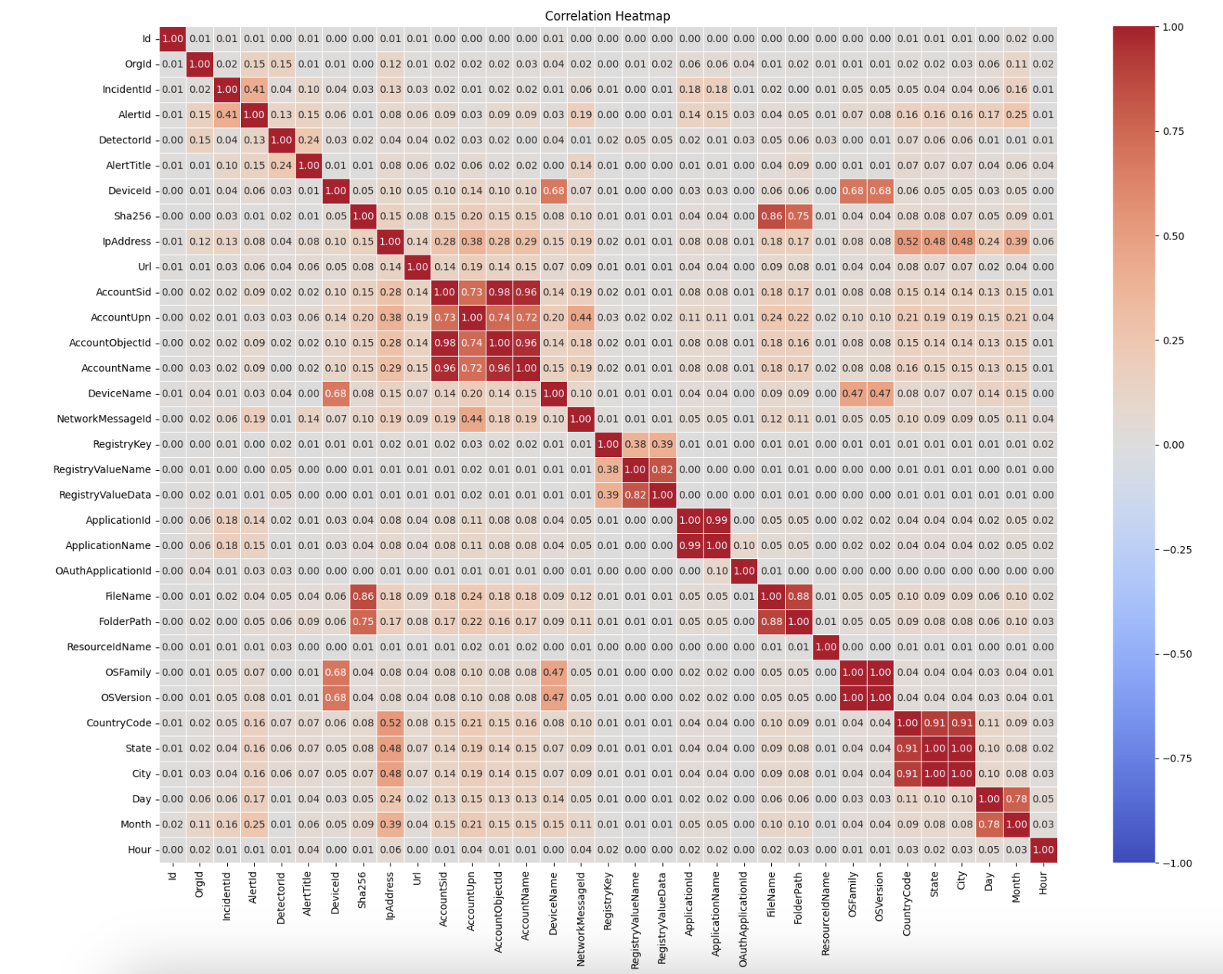
Correlation Heatmap

Slide 14
Data Splitting
Stratification:
Use stratified sampling to ensure that both the training and validation sets had similar class distributions, especially since the target variable was imbalanced. But in this case we can attempt to proceed with as is at Random Forest and XGBoost are well equipped with dealing with imbalance data and it also represents real world scenario. We can look into other methods after testing this way and evaluating it's metrics.
Train-Validation Split:
Before diving into model training, split the train.csv data into training and validation sets. This allows for tuning and evaluating the model before final testing on test.csv.
Typically, a 70-30 or 80-20 split is used, but this can vary depending on the dataset size.

Slide 15
Model Selection and Training
Baseline Model: Start with a simple baseline model, such as a logistic regression or decision tree, to establish a performance benchmark. This helps in understanding how complex the model needs to be trained.
Advanced Models: Experiment with more sophisticated models such as Random Forests, Gradient Boosting Machines (e.g., XGBoost, LightGBM), and Neural Networks. Each model should be tuned using techniques like grid search or random search over hyperparameters.
Cross-Validation: Implement cross-validation (e.g., k-fold cross-validation) to ensure the model's performance is consistent across different subsets of the data. This reduces the risk of overfitting and provides a more reliable estimate of the model's performance.

Slide 16
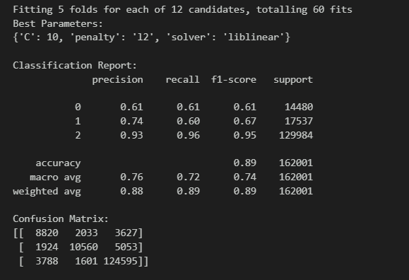
Logistic Regression :
Baseline Models
Used for binary/multiclass classification.
Models probability using a logistic (sigmoid) function.
Best for linearly separable data.

Slide 17
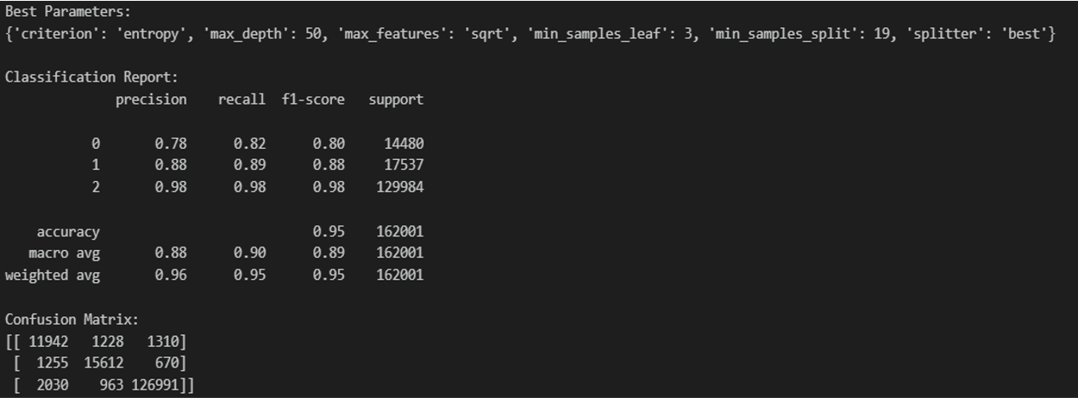
Decision Tree Classifier :
Baseline Models
Used for classification and regression.
Splits data into branches based on feature thresholds.
Prone to overfitting but easy to interpret.

Slide 18
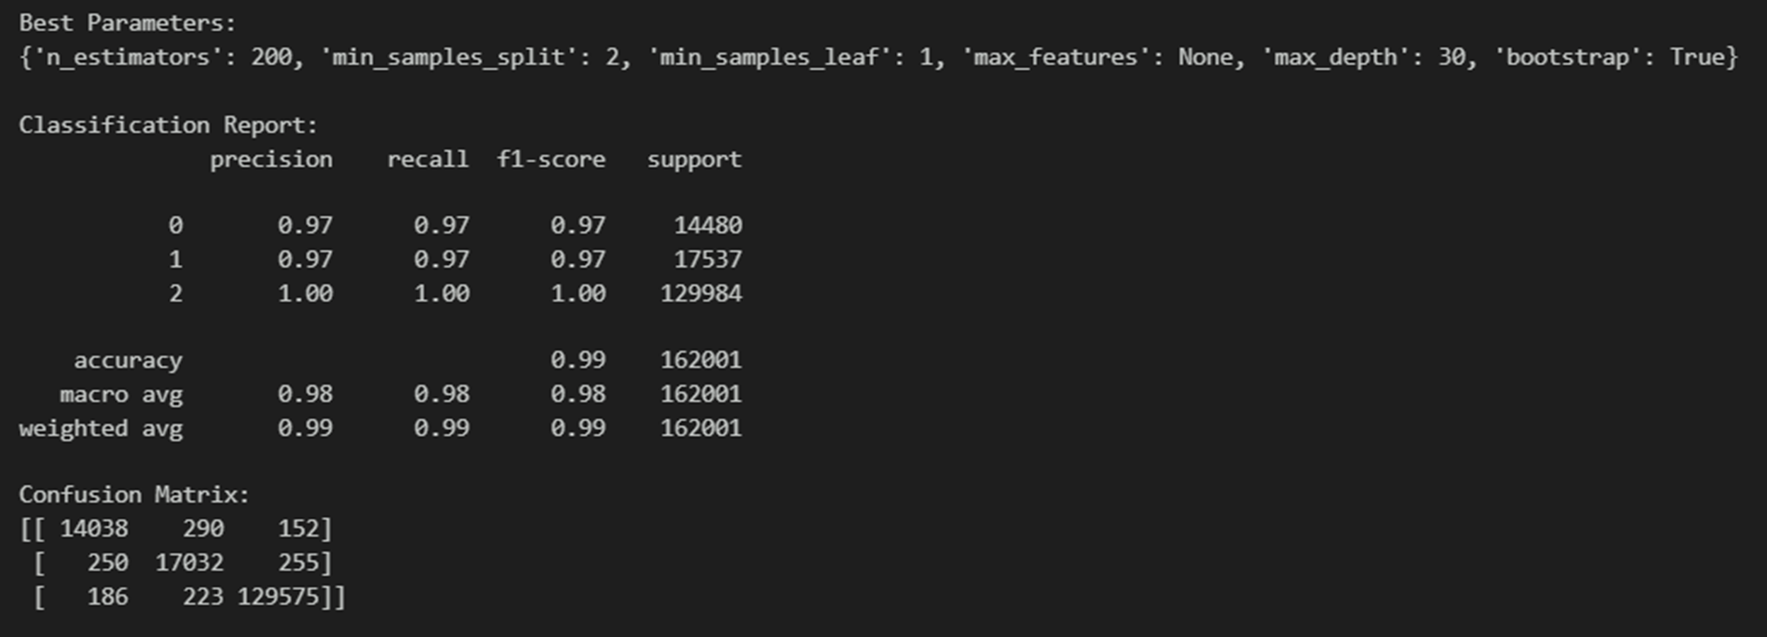
Random Forest Classifier :
Advanced Models
Ensemble of decision trees.
Reduces overfitting by averaging/voting over multiple trees.
Good for large datasets and handles high-dimensional data well.

Slide 19
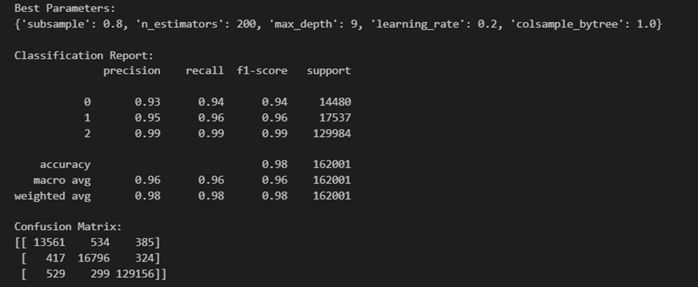
XGBoost Classifier :
Advanced Models
Optimized gradient boosting algorithm.
Builds trees sequentially, correcting errors from previous trees.
Highly effective for complex problems but requires tuning to avoid overfitting.

Slide 20
Model Evaluation and Tuning
Performance Metrics: Evaluate the model using the validation set, focusing on macro-F1 score, precision, and recall. Analyze these metrics across different classes (TP, BP, FP) to ensure balanced performance.
Hyperparameter Tuning: Based on the initial evaluation, fine-tune hyperparameters to optimize model performance. This may involve adjusting learning rates, regularization parameters, tree depths, or the number of estimators, depending on the model type.
Handling Class Imbalance: If class imbalance is a significant issue, consider techniques such as SMOTE (Synthetic Minority Over-sampling Technique), adjusting class weights, or using ensemble methods to boost the model's ability to handle minority classes effectively.

Slide 21
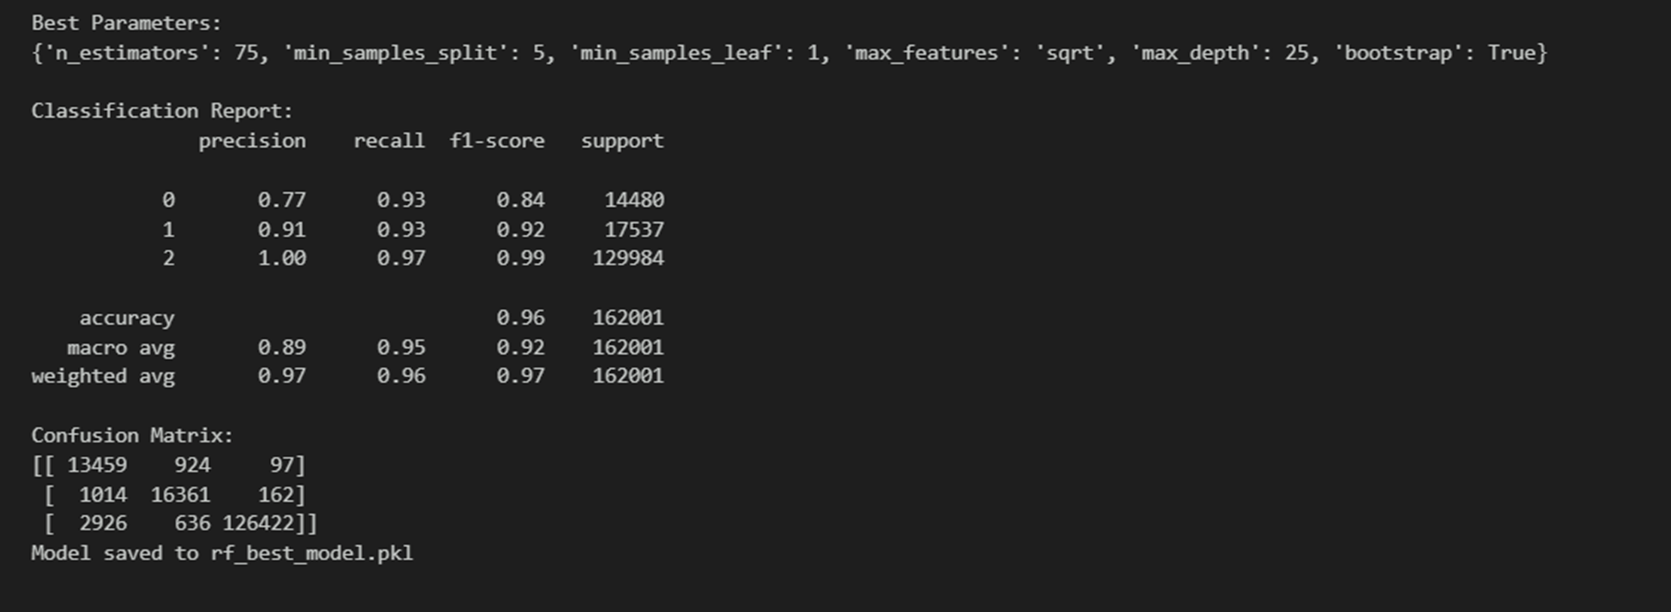
Model Evaluation and Tuning
Hypertuning with best parameters to predict the model performance and save a model as a pickle file.

Slide 22
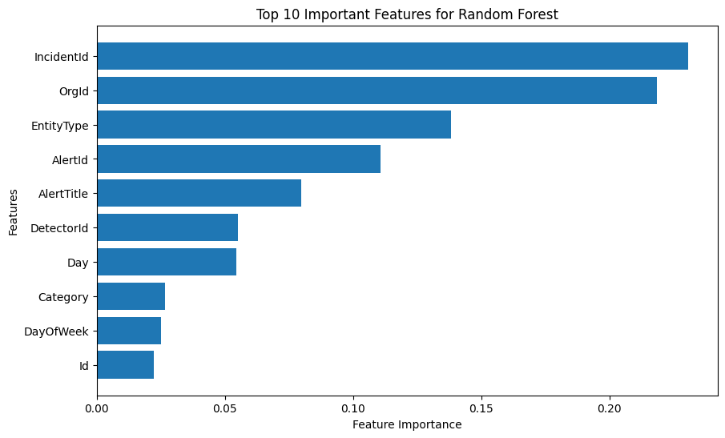
Model Interpretation
Feature Importances & Misclassified features:
Used visualizations and statistical summaries to identify patterns, correlations, and potential anomalies in the data.
Removing columns where pairs are highly correlated to avoid multicollinearity

Slide 23
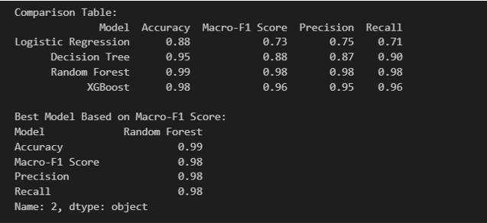
Performance metrics comparison
Compare the different model performance based on F1 score, we can see random forest has high accuracy compare to others.

Slide 24
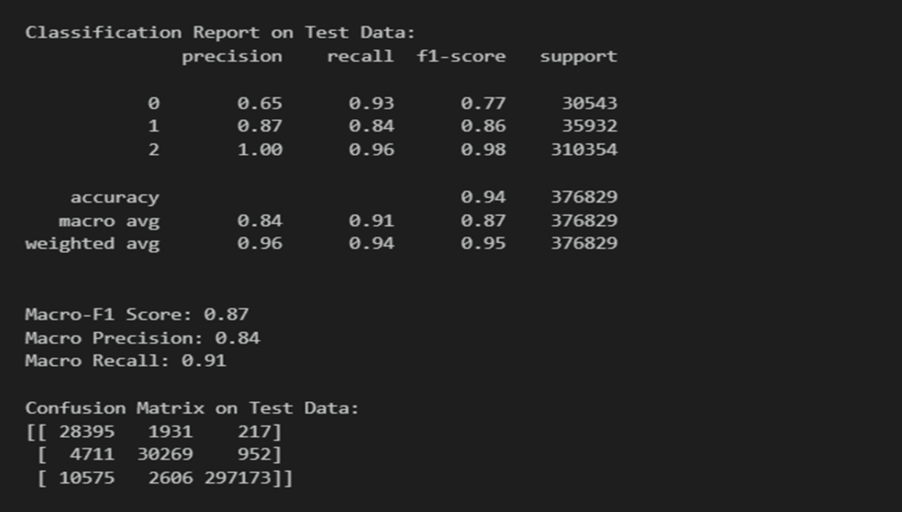
Final Results (Test Dataset)

Slide 25
Thank you

